Slide 1
Detection of Counterfeit Bangladeshi Notes Using CNN
Jahin Al Hasan Joy
CS, GSU

Slide 2
Introduction
Counterfeit currency poses a significant threat to economic stability.
Manual detection methods are inefficient and error-prone.
This project proposes an AI-based solution for detecting fake Bangladeshi currency notes using deep learning.

Slide 3
Objective
To develop a Convolutional Neural Network (CNN) model to identify fake currency notes.
To automate the detection process, minimizing human error.
To build a scalable model that can later include multiple denominations.

Slide 4
Problem Statement
Bangladesh suffers from widespread circulation of counterfeit currency.
There is a lack of easily deployable, low-cost digital solutions for real-time detection.
Need for a solution with high accuracy and efficiency for field use.

Slide 5
Dataset Collection
Images collected manually with primary focus on 100 BDT notes.
Each note captured under various lighting and angles to increase diversity.
Dataset split into training and testing folders for model validation.

Slide 6
Preprocessing Techniques
Images resized to 64×64 pixels to standardize input.
Normalization applied by scaling pixel values from [0,255] to [0,1]
Data augmentation used: shear, zoom, flip to improve model generalization.

Slide 7
Model Overview
Model based on CNN using Keras Sequential API.
Two convolutional layers followed by max pooling.
Final classification via sigmoid activated dense layer for binary output.

Slide 8
CNN Model Architecture
Conv2D(32 filters, 3x3 kernel, ReLU activation) + MaxPooling2D.
Conv2D(32 filters, ReLU) + MaxPooling2D.
Flatten layer → Dense(128, ReLU) → Dense(1, Sigmoid).
Adam optimizer with binary cross-entropy loss function.

Slide 9
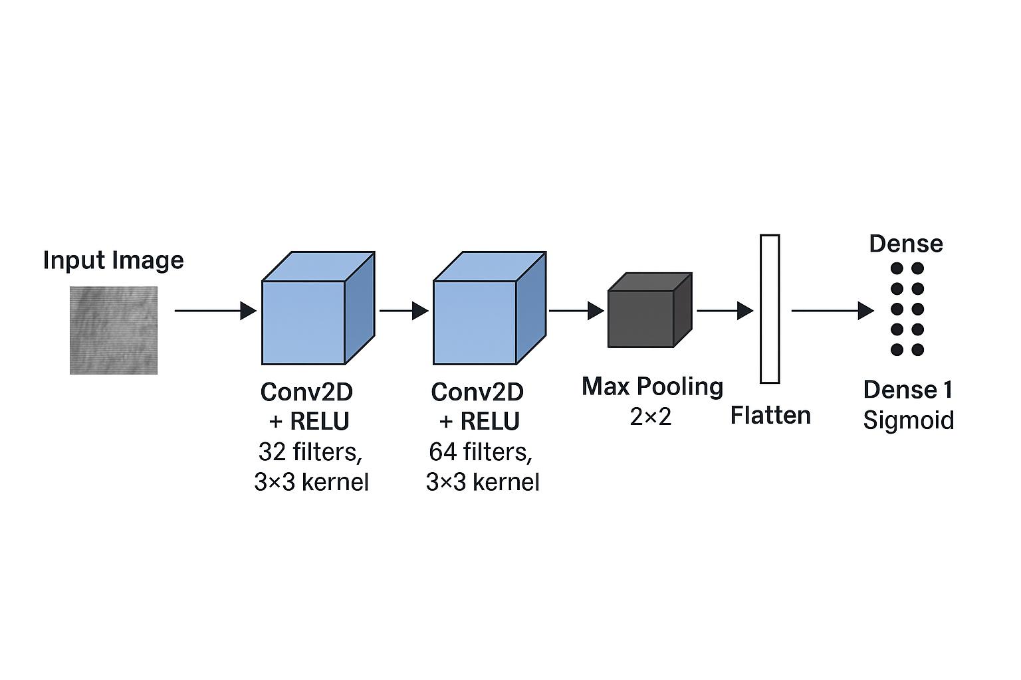
CNN Model Architecture

Slide 10
Model Training & Validation
ImageDataGenerator used to feed images with real-time augmentation.
Separate validation set used to monitor overfitting.
Training accuracy monitored over several epochs.

Slide 11
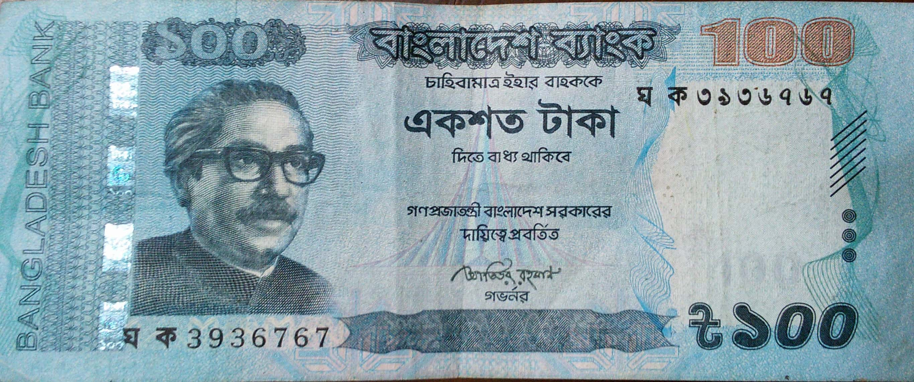
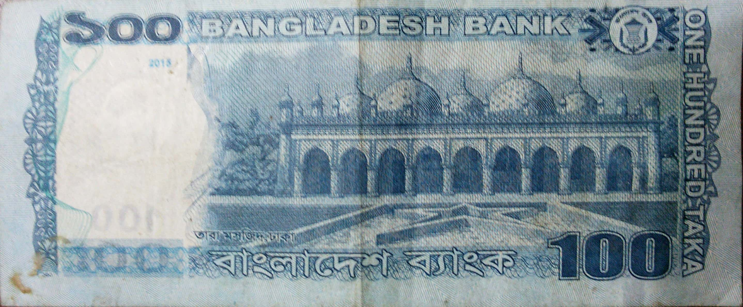

Slide 12
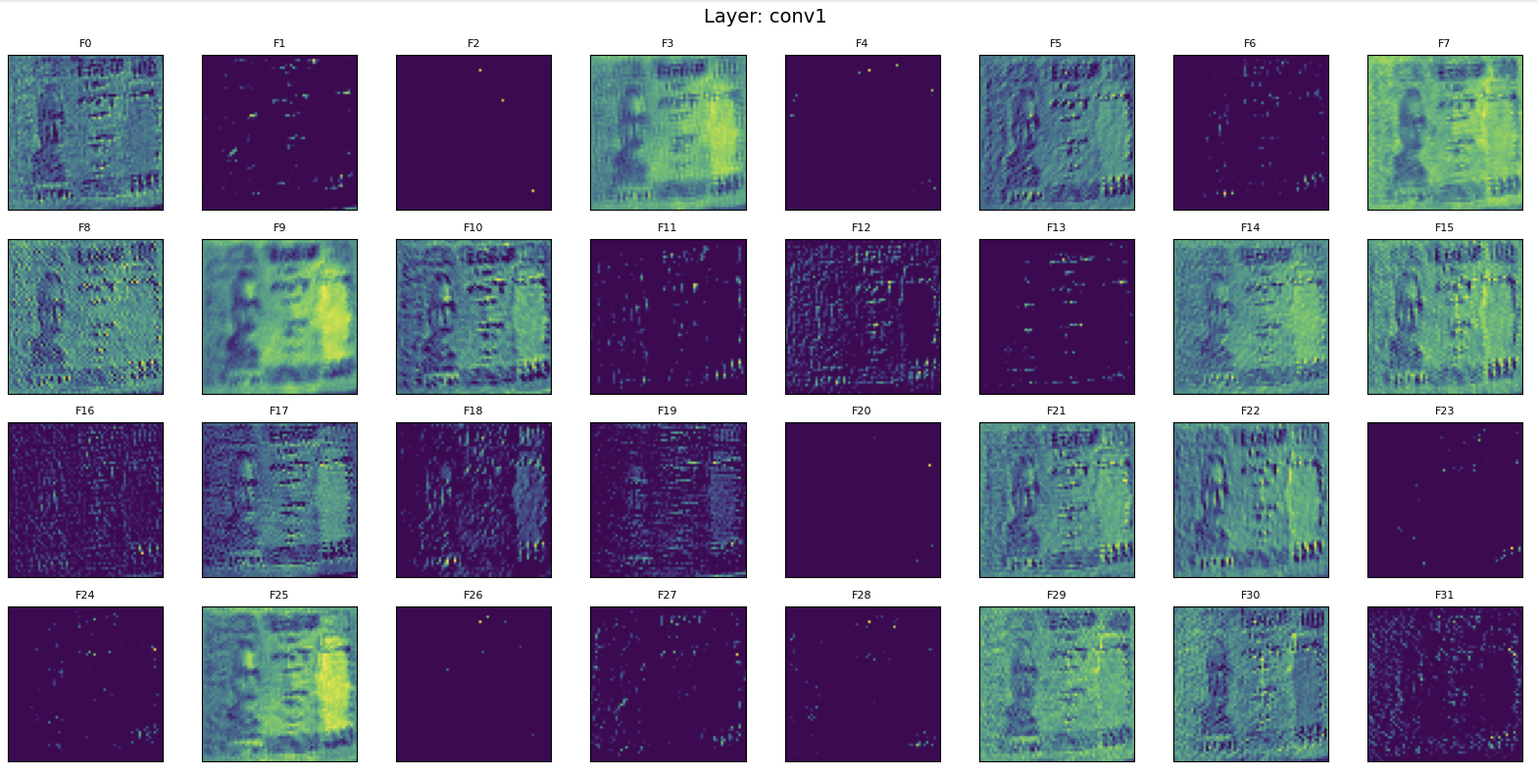

Slide 13
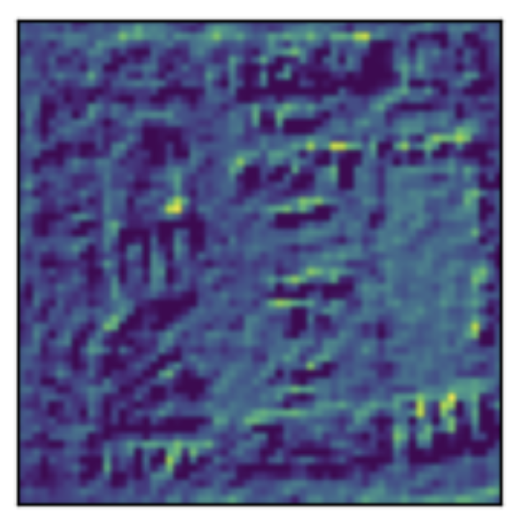

Slide 14
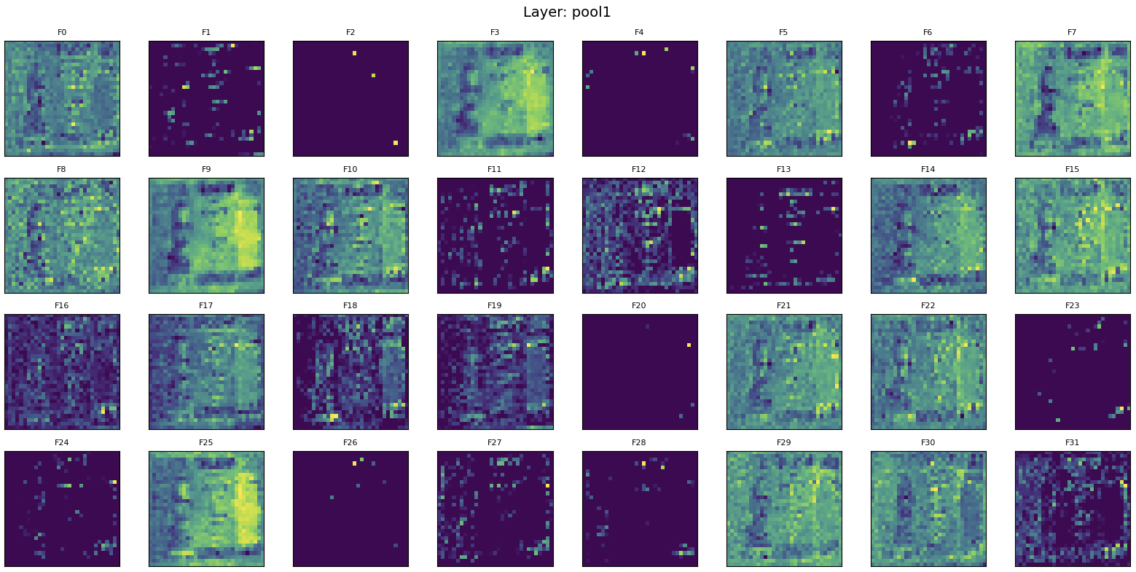

Slide 15
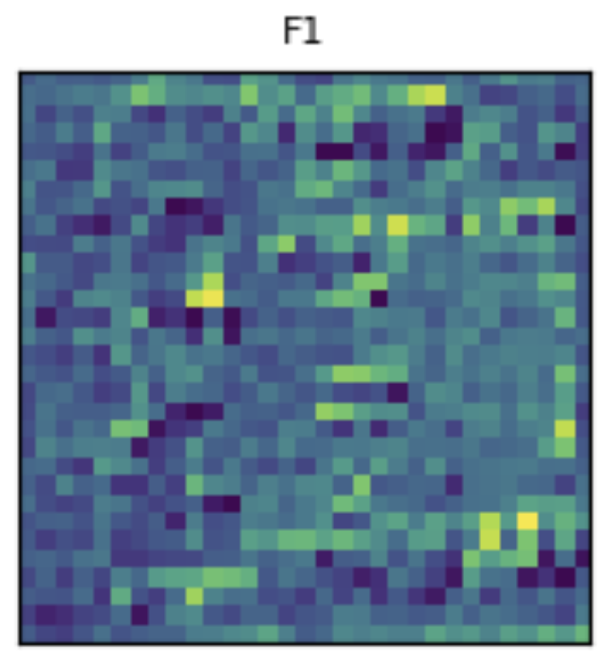

Slide 16
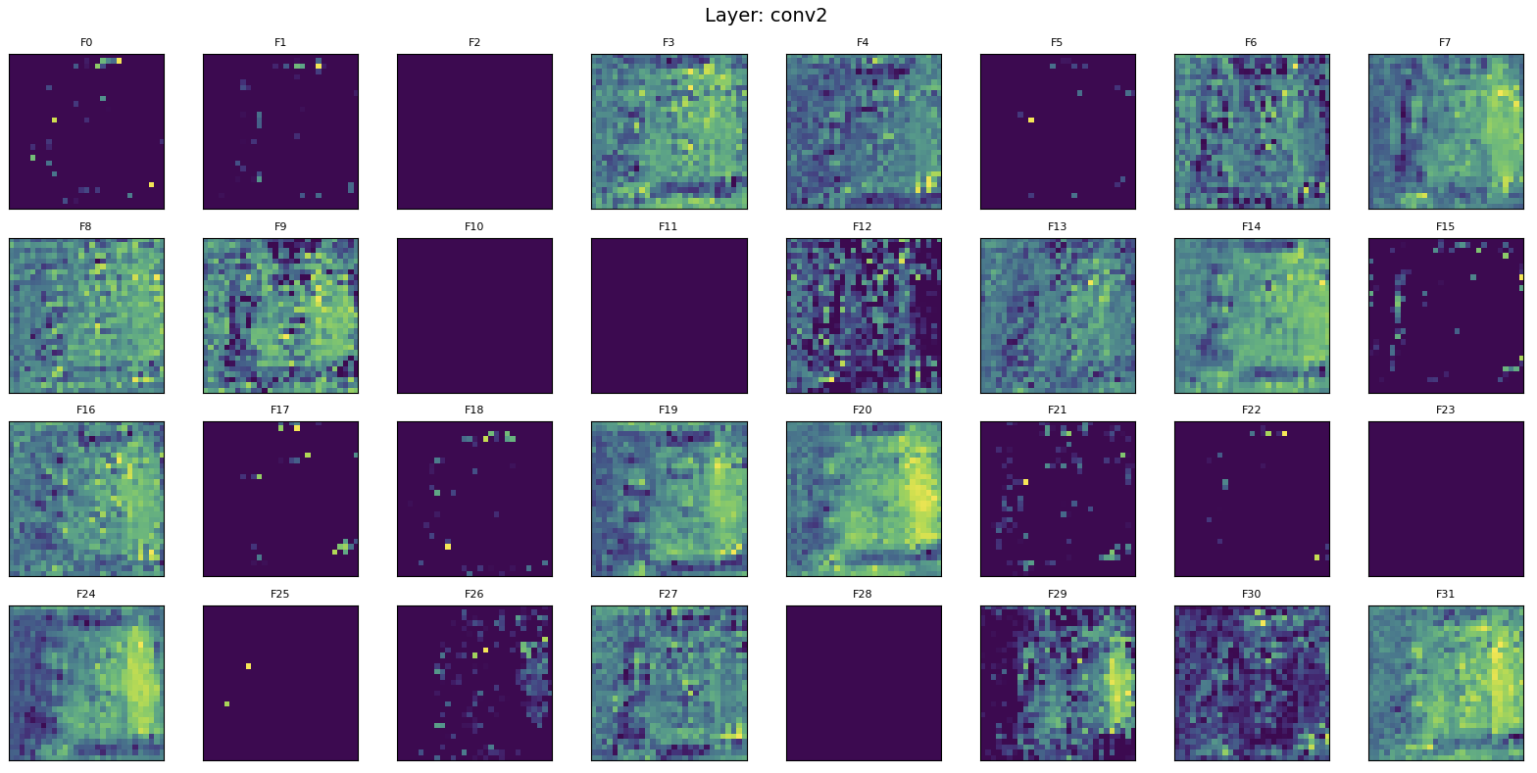

Slide 17
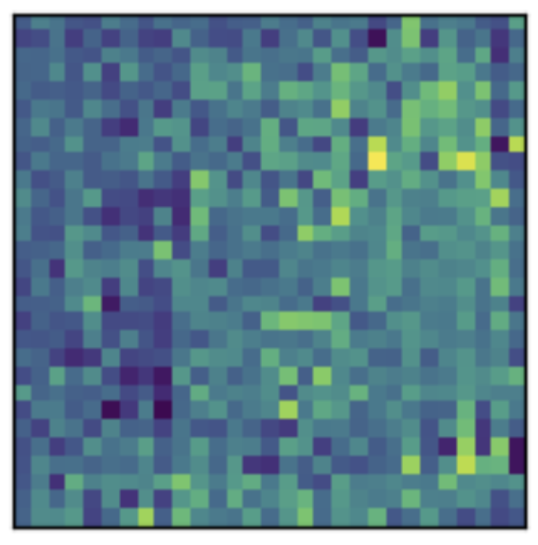

Slide 18
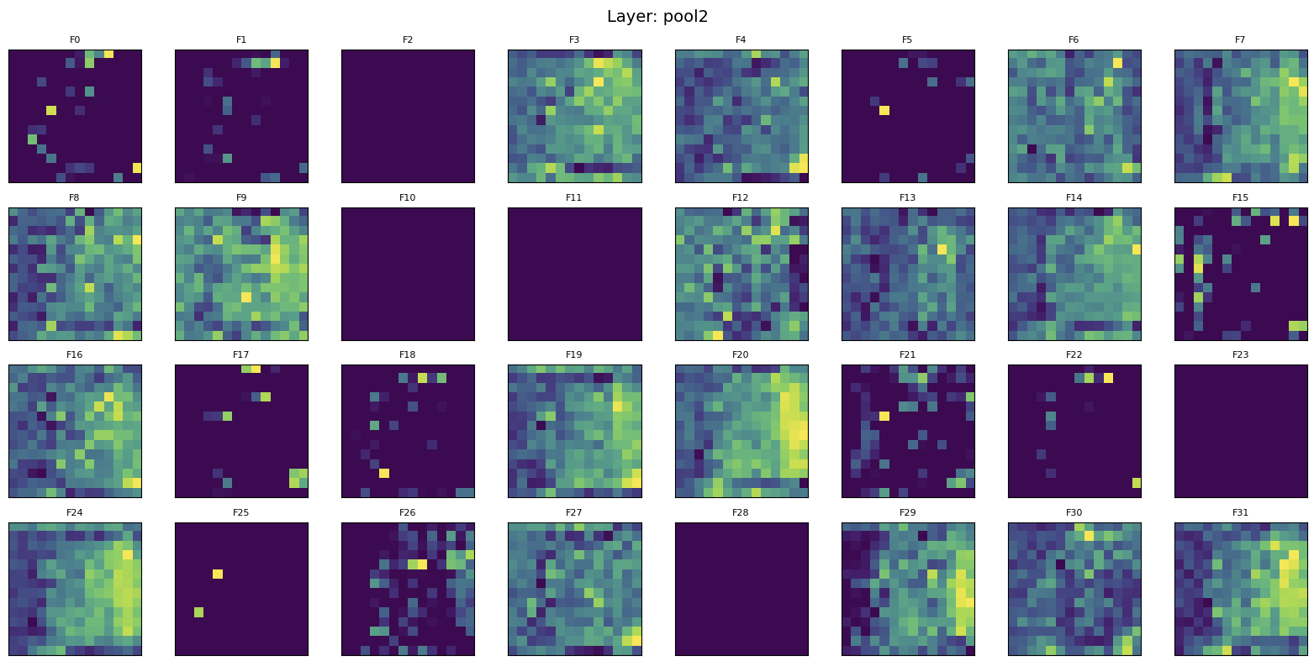

Slide 19
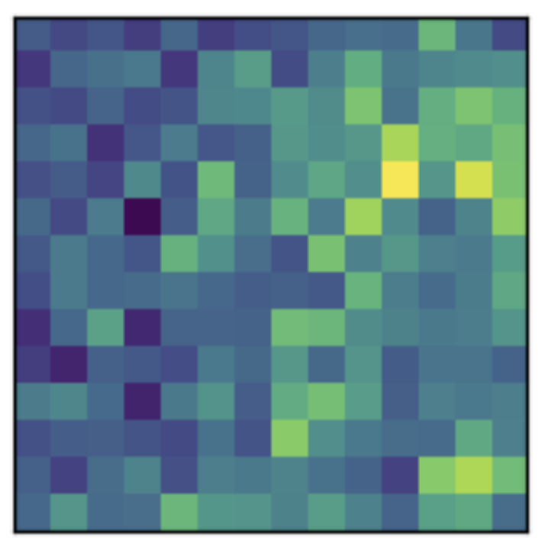

Slide 20
Challenges Faced
Limited number of labeled images for training.
Distinguishing subtle differences between real and fake notes.
Generalizing to unseen images and different note conditions.

Slide 21
Future Work
Include other denominations: 500, 1000, 2000 BDT.
Deploy as mobile app or embedded system for real-time detection.
Deploy the model for other currencies like USD, Euro etc.
Explore more advanced CNN architectures or transfer learning.

Slide 22
References
Alekhya et al., 'Fake Currency Detection Using Image Processing'
Ahmed et al., 'Feature Extraction of Bangladeshi Banknotes'
Uddin et al., 'Image-Based Detection of Counterfeit Notes'

Slide 23
Thank You

